Slide 1
Quant Curriculum
Putting it all together

Slide 2
Summary of Topics
Finance
ETFs
Bonds
Stocks
Excess Return
Risk Free Rate
Long
Short
Leverage

Slide 3
Summary of Topics cont.
Statistics
Variance
Standard Deviation
Covariance
Correlations

Slide 4
Summary of Topics cont.
Linear Algebra
Transpose
Matrix
Vector
Matrix Multiplication
Inverse

Slide 5
Risk and Variation

Slide 6
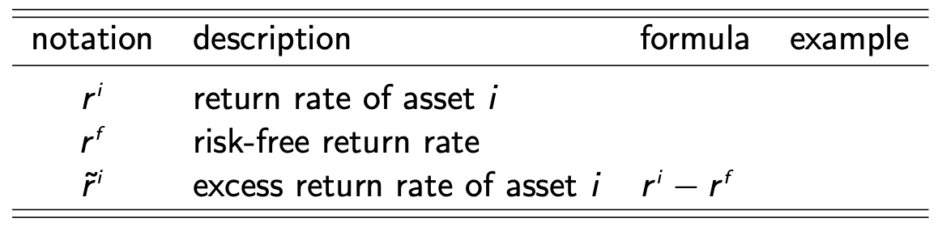
Return Notation
For one period, we can denote the return by r

Slide 7
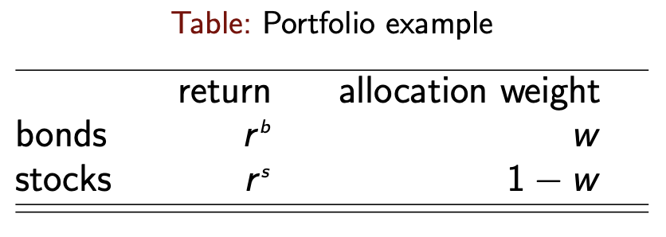
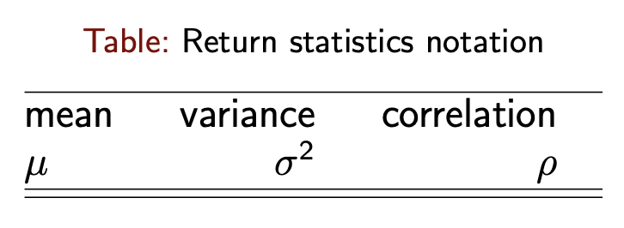
Return Notation Continued
If we consider a portfolio of return r and weight w
Where weight allocation is the percentage of each holding comprises in an investment portfolio

Slide 8

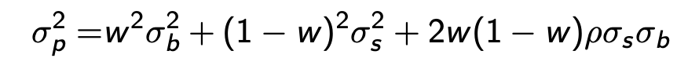
Portfolio Return Stats
Investment portfolio return r^{P} has mean and variance of

Slide 9
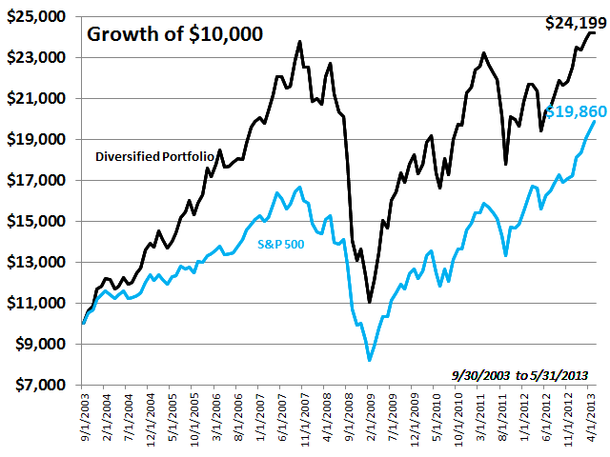
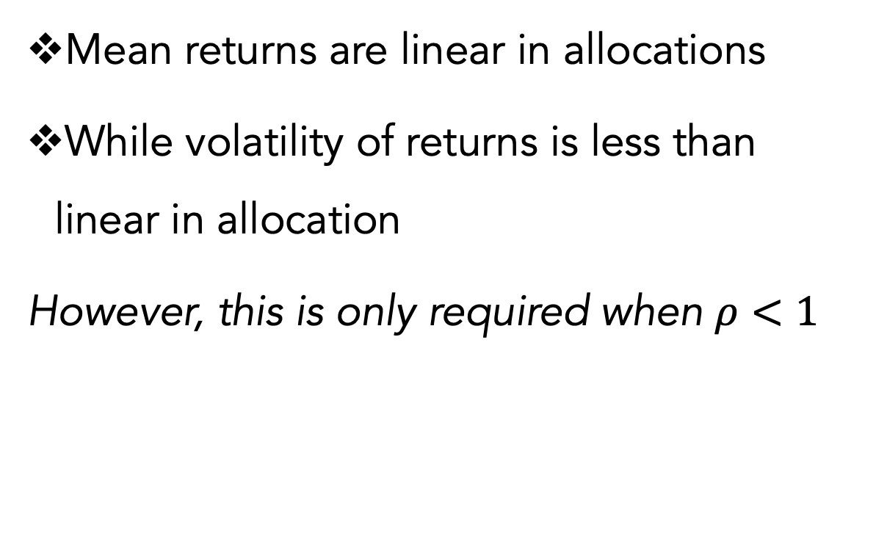
Diversification
Portfolio diversification refers to the case where:
Mean returns are linear in allocations
While volatility of returns is less than linear in allocation
However, this is only required when $ρ<1$

Slide 10
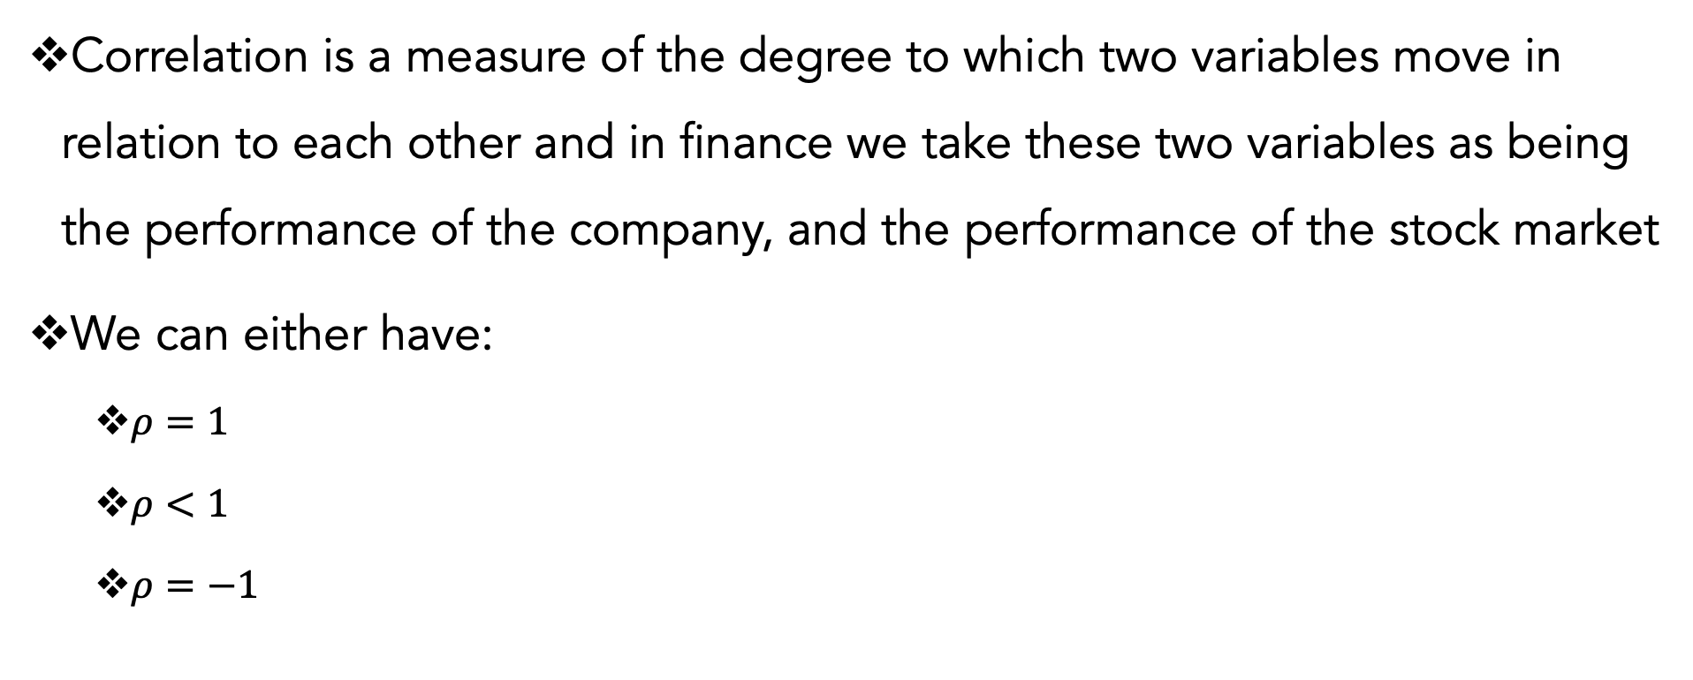
Correlation
Correlation is a measure of the degree to which two variables move in relation to each other and in finance we take these two variables as being the performance of the company, and the performance of the stock market
We can either have:
$ρ=1$
$ρ<1$
$ρ=−1$

Slide 11

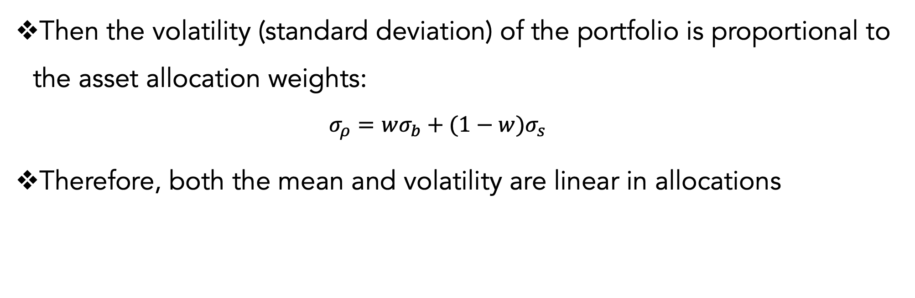
Perfect Correlation
Suppose $ρ=1$
Then the volatility (standard deviation) of the portfolio is proportional to the asset allocation weights:
$$σ_{ρ}=wσ_{b}+(1−w)σ_{s}$$
Therefore, both the mean and volatility are linear in allocations

Slide 12

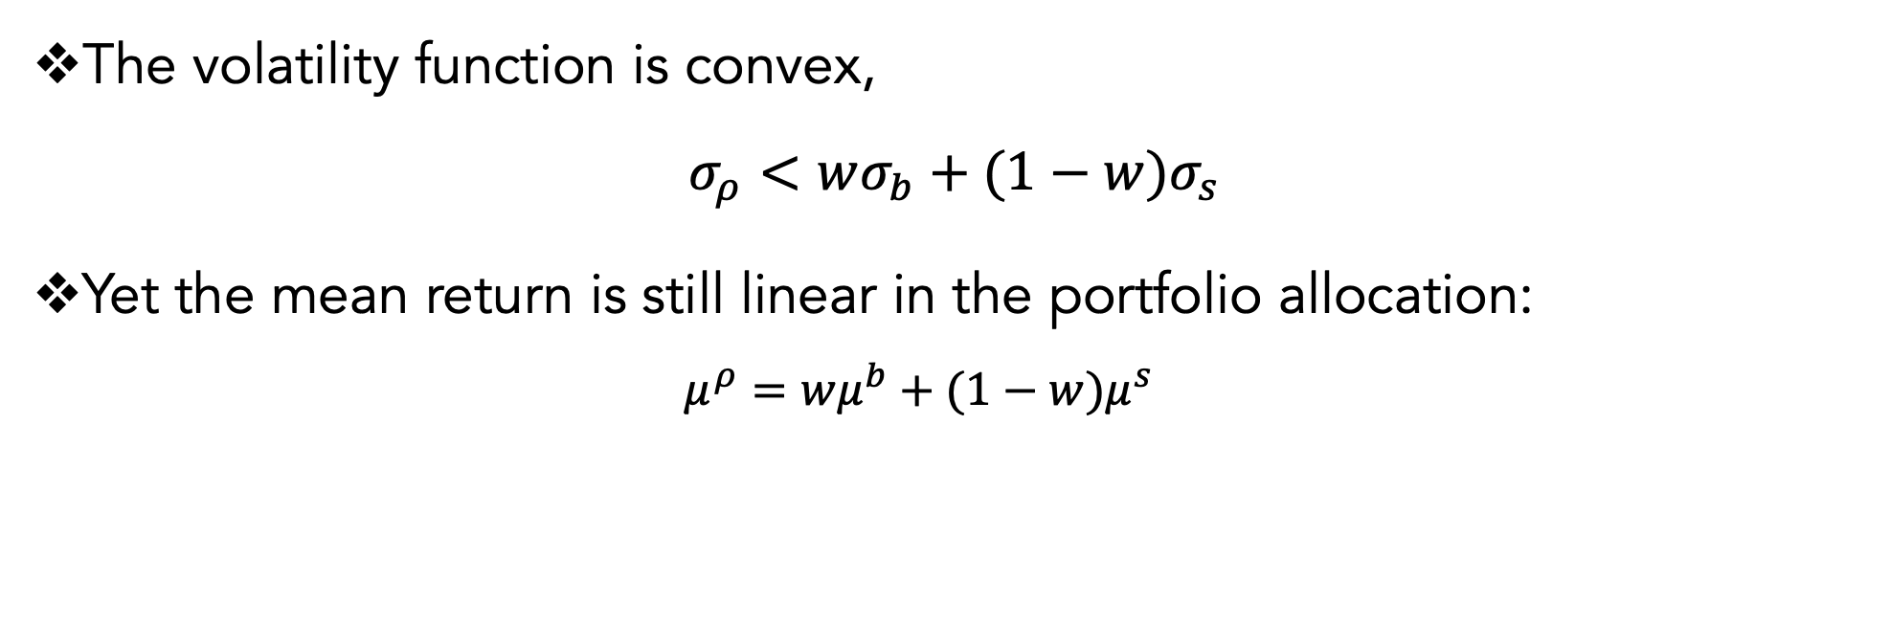
Imperfect Correlation
Suppose $ρ<1$
The volatility function is convex,
$$σ_{ρ}<wσ_{b}+(1−w)σ_{s}$$
Yet the mean return is still linear in the portfolio allocation:
$$μ^{ρ}=wμ^{b}+(1−w)μ^{s}$$

Slide 13

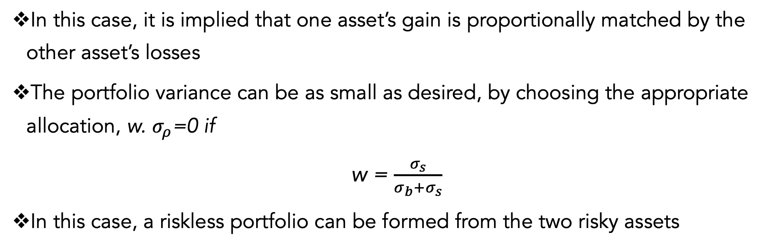
Riskless, a Perfect Hedge
Suppose $ρ=−1$
In this case, it is implied that one asset’s gain is proportionally matched by the other asset’s losses
The portfolio variance can be as small as desired, by choosing the appropriate allocation, w. $σ_{ρ}$=0 if
w = $\frac{σ_{s}}{σ_{b}+σ_{s}}$
In this case, a riskless portfolio can be formed from the two risky assets

Slide 14
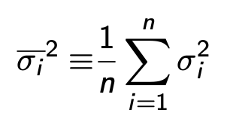
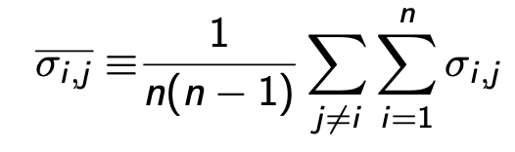
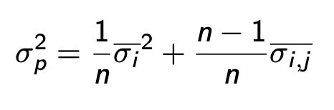
Portfolio Variance as Average Covariances
Use the following notation for averaging the variances and covariances across the n assets:
So, the portfolio variance can be written as

Slide 15
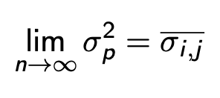
Portfolio Irrelevance of Individual Security Variance
As the number of securities in portfolio, n, gets large,
Individual security variance is unimportant and therefore, overall portfolio variance is the average of individual security covariance

Slide 16
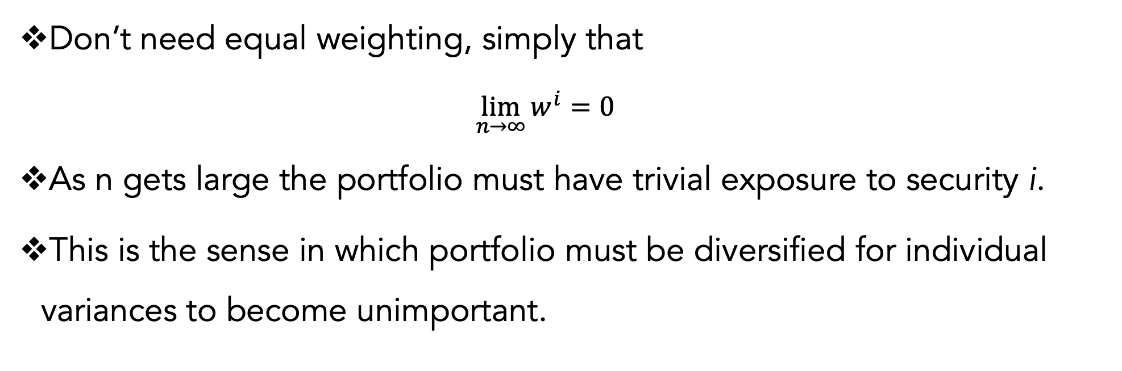
Diversified Portfolio
Obtained this result using equally-weighted portfolio, $w^{i}= \frac{1}{n}$
Don’t need equal weighting, simply that
$$\lim_{n→∞}{w^{i}}=0$$
As n gets large the portfolio must have trivial exposure to security i.
This is the sense in which portfolio must be diversified for individual variances to become unimportant.

Slide 17
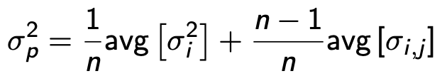
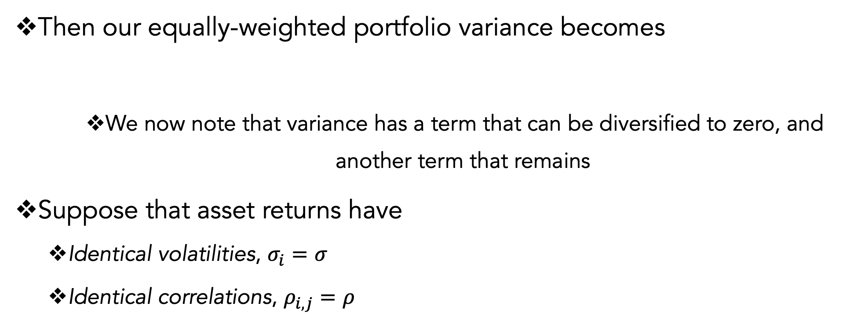
Portfolio Variance Decomposition
If we take an equally weighted portfolio, w ^{i}= 1/n.
Then our equally-weighted portfolio variance becomes
We now note that variance has a term that can be diversified to zero, and another term that remains
Suppose that asset returns have
Identical volatilities, $σ_{i}=σ$
Identical correlations, $ρ_{i,j}=ρ$

Slide 18
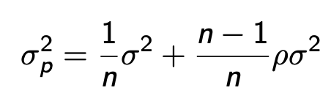
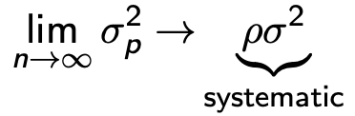
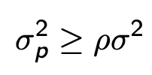
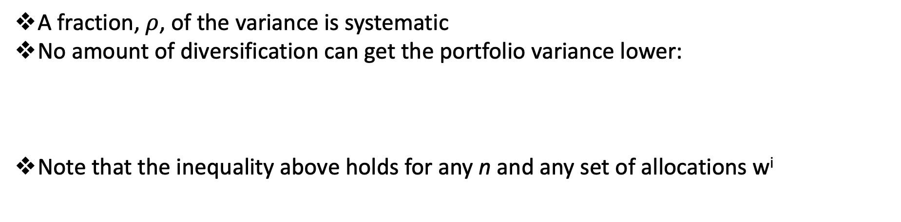
Systematic Risk
A fraction, $ρ$, of the variance is systematic
No amount of diversification can get the portfolio variance lower:
Note that the inequality above holds for any n and any set of allocations w^{i}

Slide 19
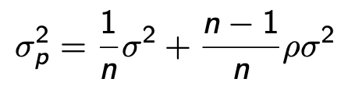
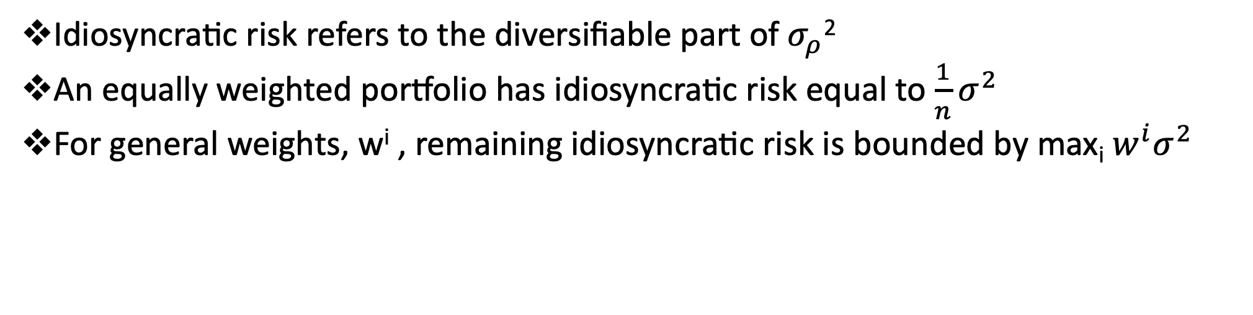
Idiosyncratic Risk
Idiosyncratic risk refers to the diversifiable part of $σ_{ρ}$²
An equally weighted portfolio has idiosyncratic risk equal to $\frac{1}{n}σ^{2}$
For general weights, w^{i} , remaining idiosyncratic risk is bounded by max_{i} $w^{i}σ^{2}$

Slide 20
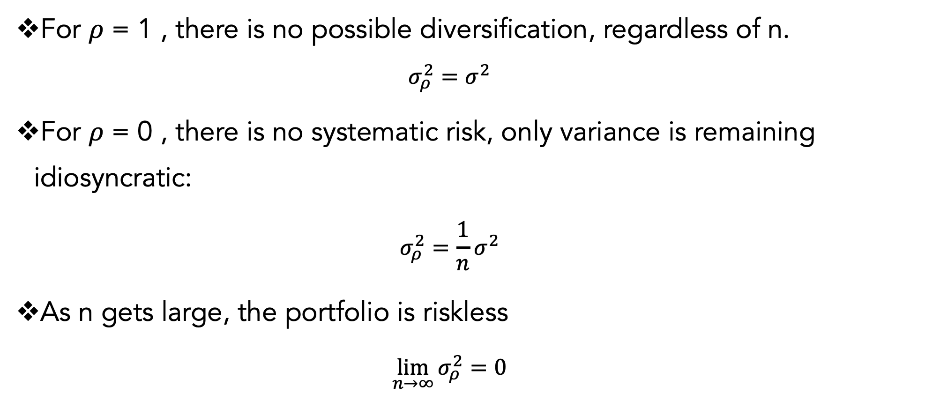
Correlation and Diversified Portfolios
For $ρ$ = 1 , there is no possible diversification, regardless of n.
$$σ_{ρ}^{2}=σ^{2}$$
For $ρ$ = 0 , there is no systematic risk, only variance is remaining idiosyncratic:
$$σ_{ρ}^{2}=\frac{1}{n}σ^{2}$$
As n gets large, the portfolio is riskless
$$\lim_{n→∞}{σ_{ρ}^{2}}=0$$

Slide 21
Mean Variance

Slide 22
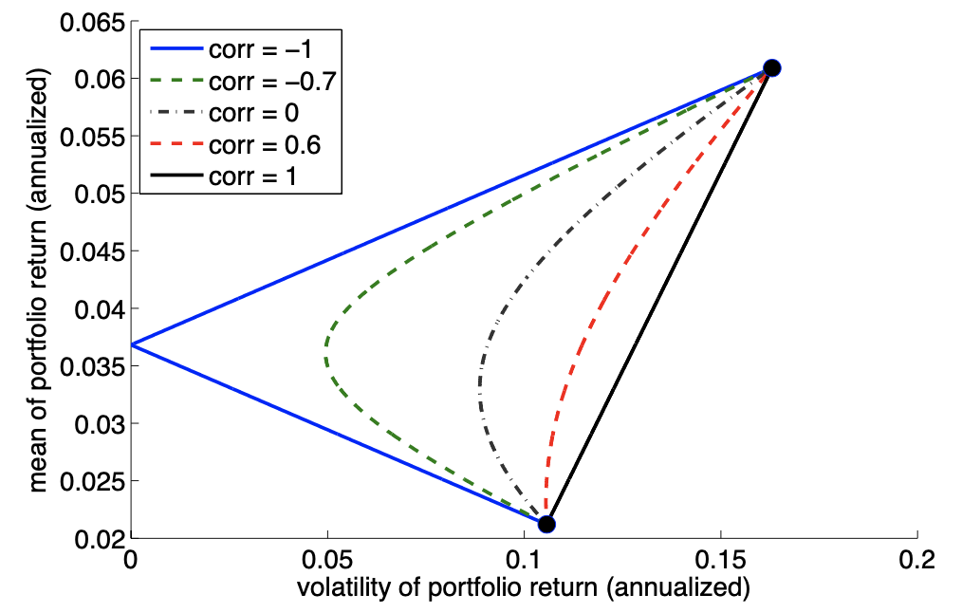
Mean Variance Comparisons
We want to compare risk and return and so we must
Use mean return to score the portfolio’s benefits
Use variance (or volatility) of return to score the portfolio’s risk

Slide 23
Diversification across n assets
With n securities, there is further potential for diversification
The set of all possible portfolios formed from this basis of assets forms a convex set in mean-variance space.
The boundary of this set is known as the mean-variance frontier, and it forms a parabola.
The boundary of the set in mean-volatility space forms a hyperbola.
We use MV frontier to refer to both the mean variance and mean-volatility frontiers.

Slide 24
Example. Mean-variance frontier formed by 25 U.S. equity portfolios, sorted by size and and book/market.

Slide 25
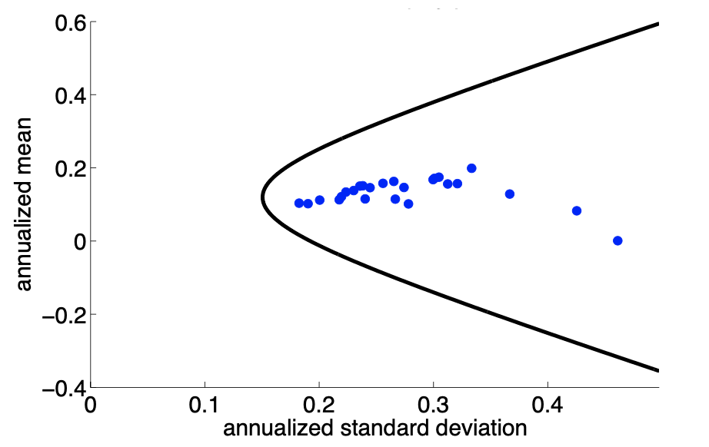
Mean-volatility frontier formed by 25 U.S. equity portfolios, sorted by size and and book/market.

Slide 26
Efficient Portfolios
The top segment of the MV frontier is the set of efficient MV portfolios.
These portfolios maximize mean return given the return variance.
Contrast this with the lower segment of the MV frontier, the inefficient MV portfolios.
The inefficient MV portfolios minimize mean return given the return variance.

Slide 27


Notation
Suppose there are n risky assets
r is an n × 1 random vector. Each element is the return on one of the n assets.
Let μ denote the n × 1 vector of mean returns. Let Σ denote the n × n covariance matrix of returns.
Assume Σ is positive definite—no asset is a linear function of the others.

Slide 28
With a Riskless Asset
Now consider the existence a risk-free asset with return, $r^{f}$
There are n risky assets available, with returns as r
An investor chooses a portfolio, defined as a n × 1 vector of allocation weights, w, in those n risky assets
Since the total portfolio allocations must add to one, we have allocation to the risk-free rate = 1 − w′1

Slide 29





Mean Excess Returns
μ denotes the vector of mean returns of risky assets, $𝔼$ [r ].
Let μp denote the mean return on a portfolio.
Use the following notation for excess returns:
Thus, the mean return and mean excess return of the portfolio are

Slide 30

Variance of Return
The risk-free rate has zero variance and zero correlation with any security.
Let Σ continue to denote the n × n covariance matrix of risky assets, (and is positive semi-definite.)
The return variance of the portfolio, wp is

Slide 31


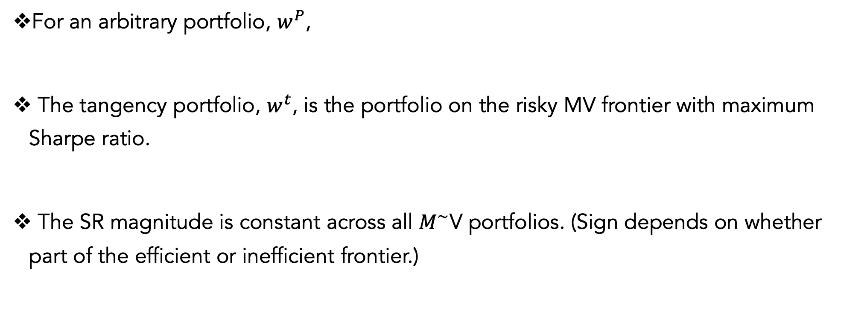
Tangency portfolio and the Sharpe ratio
For an arbitrary portfolio, $w^{P}$,
The tangency portfolio, $w^{t}$, is the portfolio on the risky MV frontier with maximum Sharpe ratio.
The SR magnitude is constant across all $M^{\sim }$V portfolios. (Sign depends on whether part of the efficient or inefficient frontier.)

Slide 32
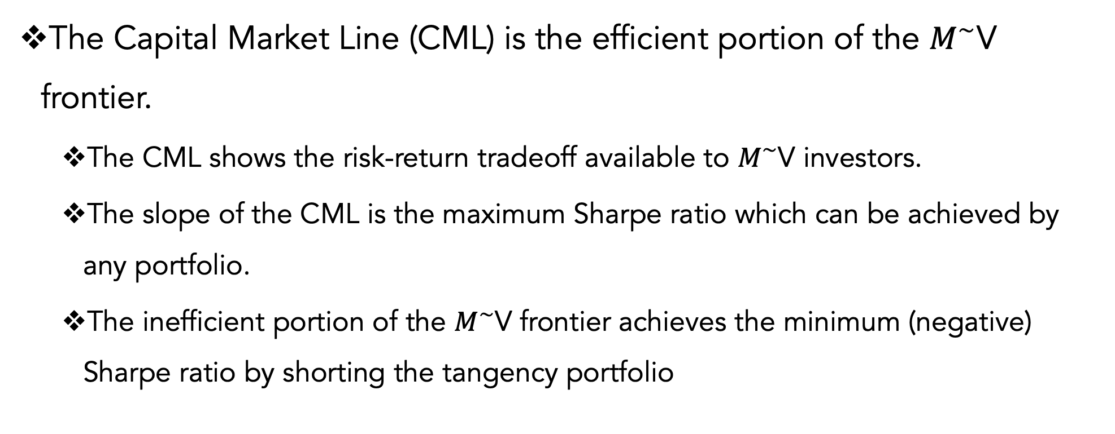
Capital Market Line
The Capital Market Line (CML) is the efficient portion of the $M^{\sim }$V frontier.
The CML shows the risk-return tradeoff available to $M^{\sim }$V investors.
The slope of the CML is the maximum Sharpe ratio which can be achieved by any portfolio.
The inefficient portion of the $M^{\sim }$V frontier achieves the minimum (negative) Sharpe ratio by shorting the tangency portfolio

Slide 33
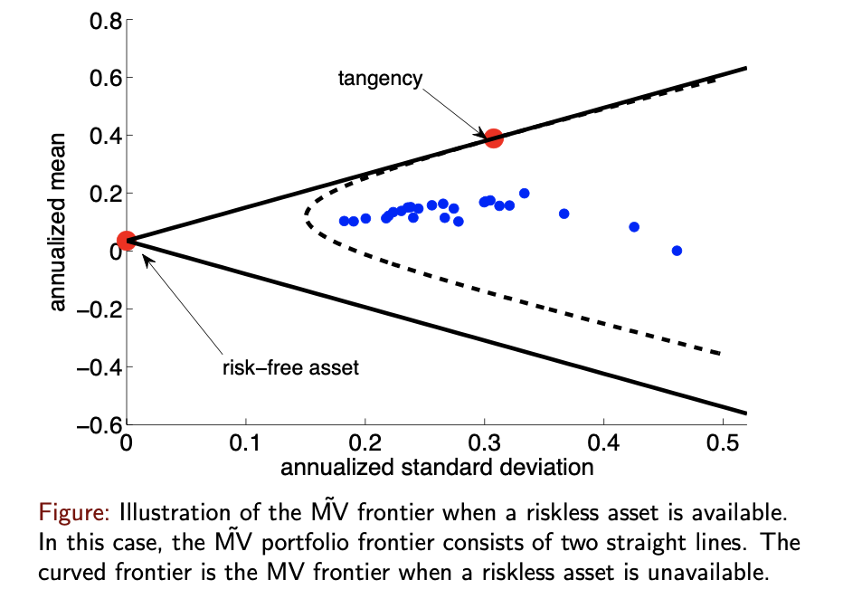
PLACEHOLDER

Slide 34
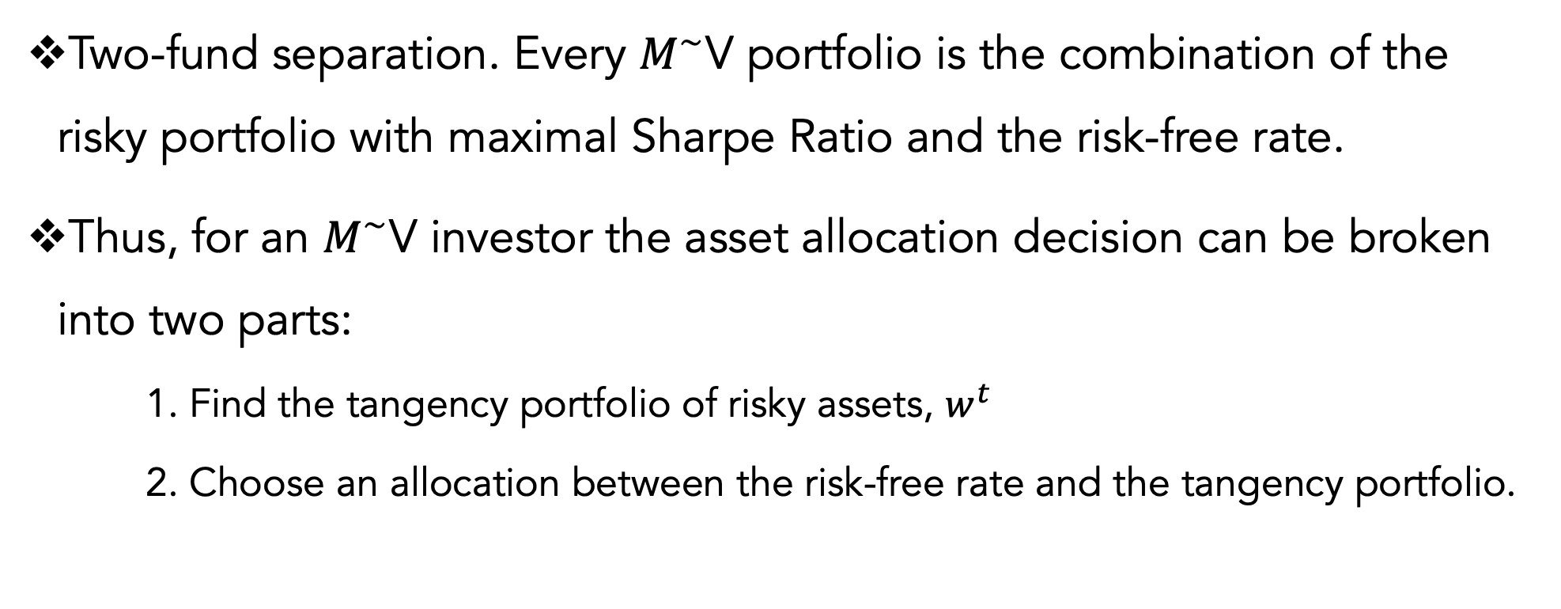
Two-Fund Separation
Two-fund separation. Every $M^{\sim }$V portfolio is the combination of the risky portfolio with maximal Sharpe Ratio and the risk-free rate.
Thus, for an $M^{\sim }$V investor the asset allocation decision can be broken into two parts:
1. Find the tangency portfolio of risky assets, $w^{t}$
2. Choose an allocation between the risk-free rate and the tangency portfolio.

Slide 35
Intuition of Asset Allocation
The two-fund separation says that
Any investment in risky assets should be in the tangency portfolio since it offers the maximum Sharpe Ratio.
One must decide the desired level of risk in the investment, which determines the split between the riskless asset and the tangency portfolio.

Slide 36
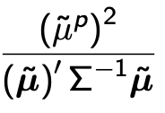
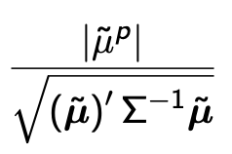
$M^{\sim }$V Portfolio Variance Formula
The return variance of an MV portfolio is given by
This implies that the return volatility (standard-deviation) is linear in the absolute value of the mean excess return:

Slide 37
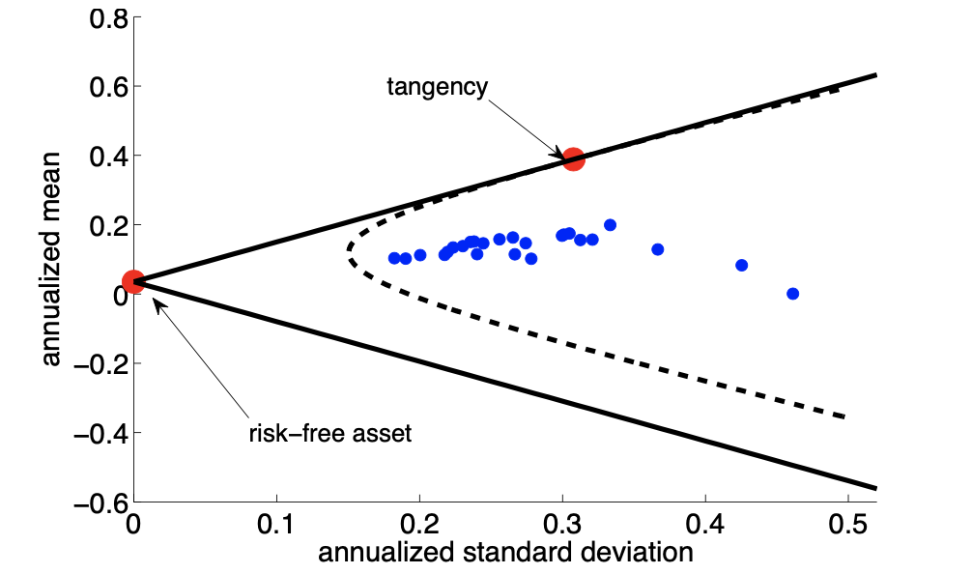
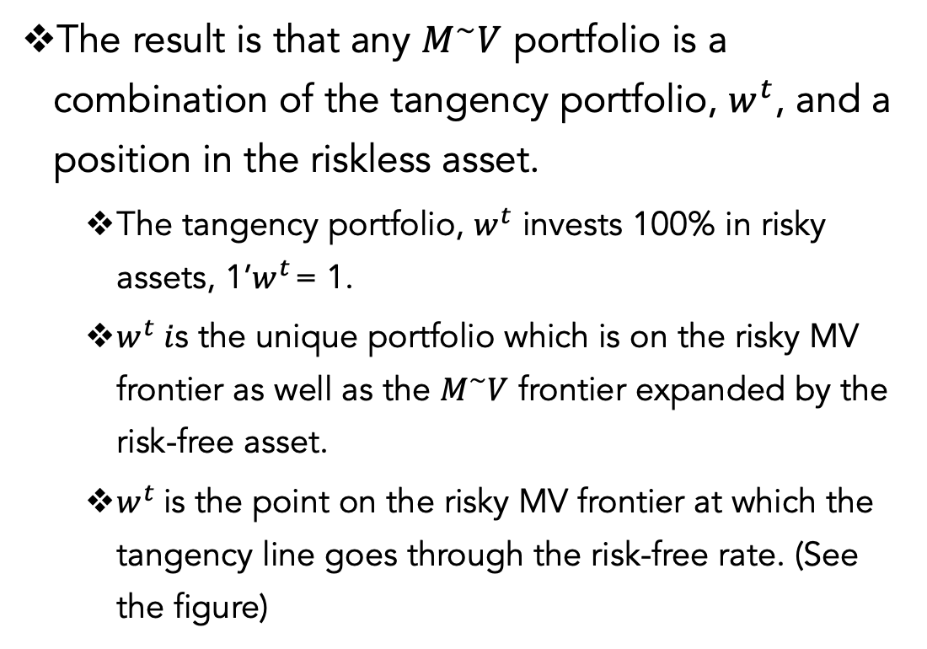
Tangency Portfolio
The result is that any $M^{\sim }V$ portfolio is a combination of the tangency portfolio, $w^{t}$, and a position in the riskless asset.
The tangency portfolio, $w^{t}$ invests 100% in risky assets, 1’$w^{t}$ = 1.
$w^{t} i$s the unique portfolio which is on the risky MV frontier as well as the $M^{\sim }V$ frontier expanded by the risk-free asset.
$w^{t}$is the point on the risky MV frontier at which the tangency line goes through the risk-free rate. (See the figure)

Slide 38
Slide with python weighting data for mean variance

Slide 39
Problems with Mean Variance
Sensitized to In-Sample
Market movements change and portfolio is not great out of sample
Unrealistic weightings

Slide 40
Diagonalized Mean-Variance Placeholder

Slide 41
Questions?

